Slide 1

SMART TRAFFIC MANAGEMENT SYSTEM
Presented by :
Manoj Kumar (20R21A0498)
Varun Shanagapati (21R25A0405)
Venu Ponnana (21R25A0411)

Slide 2
ABSTRACT:
In-country like India, billions of people start and end each working day stuck in traffic or commuting on congested trains and buses. It is vital to the quality of life to enhance the everyday commute.
Slowed synchronization of traffic signals leads to traffic congestion and delays.
The pre-programmed, regular signal timing patterns are employed in traditional signal systems.
The Adaptive Traffic Control System (ATCS) is a traffic management technique that modifies or adapts the timing of traffic signals based on the real demand for traffic and achieved using a control system that includes both hardware and software, where hardware is the sensor used for real-time traffic density estimation and software is designed using captured data analysis of the city's current traffic flow.

Slide 3
INTRODUCTION
Congestion of traffic has been a matter of routine in any existing metropolitan region with an overwhelming population but minimal infrastructure. Traffic Congestion is a critical problem with dire causes and consequences on the road.
Radical population growth and low public quality transportation have caused vehicles to expand massively.
Poorly controlled traffic, apart from infrastructure, creates congestion that could survive for hours. Only to a certain degree can a pre-defined timing scheme for traffic control ease the problem.
The solution to these problems is to provide an adaptive system that works in accordance with the number of vehicles lanes. This traffic system counts the number of vehicles in the lane, compares the data from other lanes, and, based on the number of vehicles, determines whether to offer priority to reducing the average waiting time or reducing congestion/pollution in the lane.

Slide 4
OBJECTIVES:
Traffic Flow Optimization: Ensure smoother and more efficient traffic flow by dynamically managing signal timings, lane assignments, and speed limits.
Congestion Reduction: Minimize traffic congestion and gridlock by monitoring traffic conditions in real-time and implementing responsive measures.
Safety Improvement: Enhance road safety by detecting and responding to accidents, traffic violations, and other hazards promptly.
Incident Management: Detect and respond to incidents such as accidents, road closures, and adverse weather conditions to minimize their impact on traffic.
Enforcement: Use technology to enforce traffic rules and regulations, such as red-light cameras and speed cameras.

Slide 5
SOFTWARE REQUIRED:
PYTHON IDE
LIBRARIES REQUIRED:​
NUMPY
PANDAS
TENSOR FLOW
SKLEARN
OPEN CV
ULTRALYTICS

Slide 6
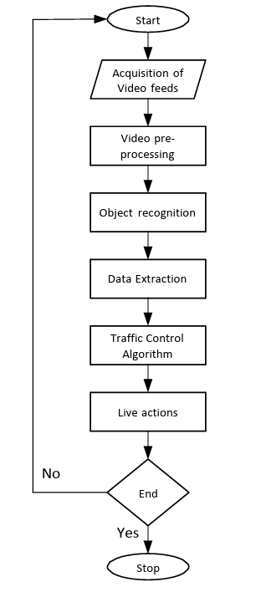
ARCHITECTURE:

Slide 7
QUESTIONS:
How can emerging technologies, such as 5G and IoT, be leveraged to enhance the effectiveness of STMS?
How can artificial intelligence and machine learning algorithms be used to improve traffic prediction and optimization within STMS?
What are the most effective methods for dynamically adjusting traffic signal timings in response to real-time traffic conditions?
What is the impact of STMS on reducing vehicle emissions and promoting sustainable transportation options?

Slide 8
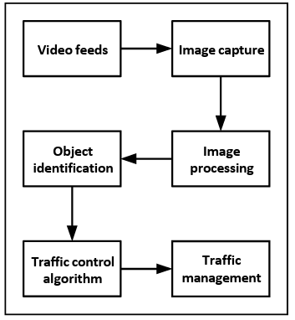
METHODOLOGY:

Slide 9
IMPLEMENTATION OF STMS USING OPENCV
To optimally overcome traffic congestion, decisions to trigger traffic signals need to be based on real-time results. The following steps were followed as part of adaptive traffic control.
A. Video feed acquisition:
The control algorithm is intended to control 4-way and 2- way approach intersection. This includes taking video data from various cameras and manipulating the input by suitable filters and algorithms.
The video feed is obtained via the automated operations supported by OpenCV using the Direct Display (Dshow) techniques.
B. Pre-processing of video:
Video processing is achieved by the repeated trials of the techniques of image processing to video frames. Video feeds from various cameras are collected and analyzed frame by frame in real time.
Video pre-processing methods are used to enhance efficiency and precision in the calculation of traffic flow.

Slide 10
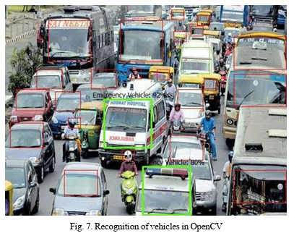
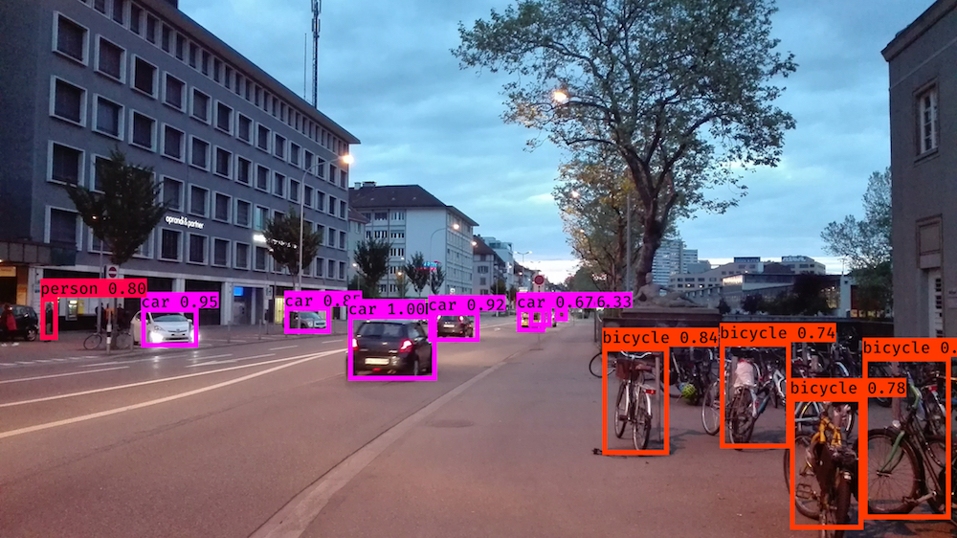
C. Recognition of object:
The "YOLO" classifier with Open Cv is used for the recognition of object.
YOLO (You Only Look Once) is a method / way to do object detection. It is the algorithm /strategy behind how the code is going to detect objects in the image.
YOLO takes entirely different approach. It looks at the entire image only once and goes through the network once and detects objects. Hence the name. It is very fast. That’s the reason it has got so popular.
This Photo by Unknown author is licensed under CC BY.

Slide 11
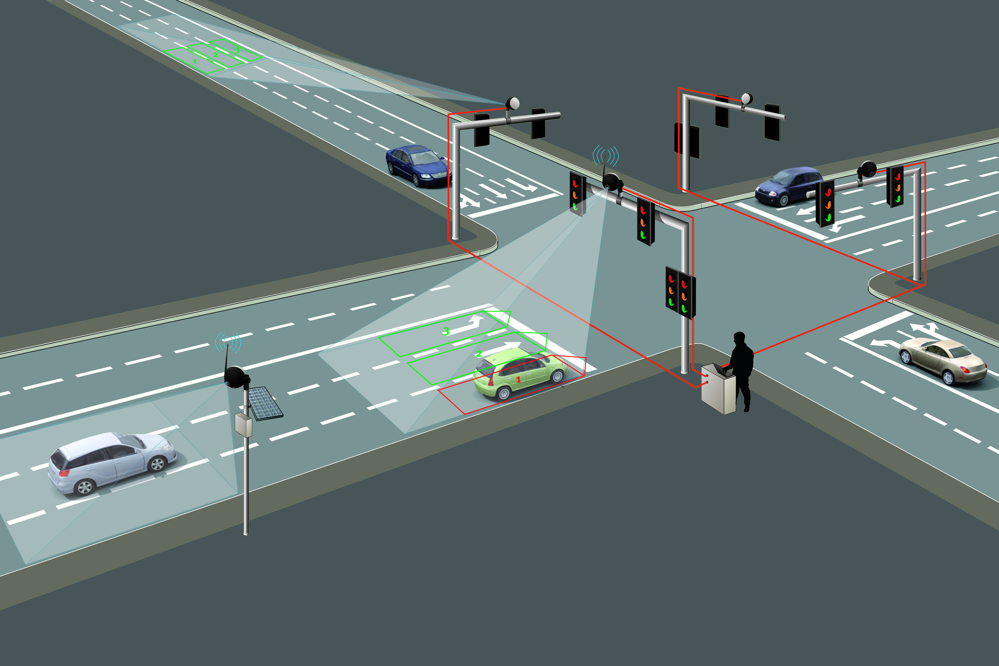
D. Extraction of data:
Data Extraction refers to the acquisition of data/information that is most suited to our specifications from pre-processed video streams.
For our analysis, we only needed the total number of items observed, which will apply to the number of vehicles in the queue at the traffic intersection approach.
The cumulative number of vehicles recognized shall be taken into account. The count for each approach of the intersection shall be fed to the algorithm for the determination of the appropriate action.

Slide 12
Traffic control algorithm:
The control algorithm is responsible for controlling traffic at the intersection when is supplied with data. ​
The control algorithm is based on what area the vehicles are occupied frame. If traffic is greater than 80% of the total area, then maximum time tmax is allotted to the lane. If the traffic of the lane is less than 25% then minimum time tmin is allotted to the lane.​
The emergency vehicles are given a special priority access,so that when a emergency vehicle is detected then the system is overridden by special request and maximum time is alloted to that lane.​
So,when the emergency vehicles like ambulance spotted on the lane ,the special priority will be given.​

Slide 13
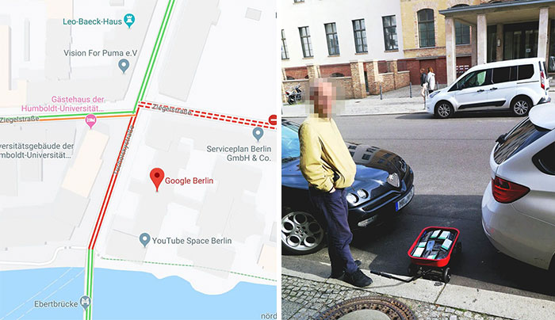

Slide 14
GITHUB LINK:
https://github.com/M-K-08/SMART-TRAFFIC-MANAGEMENT-SYSTEM-

Slide 15
CONCLUSION:
The key benefit of the STMS framework is that it is stable and easy to install.
Using image processing technique, the calculation of the length of the queue across junctions can prove to be more accurate than conventional inferential sensing devices and infrared sensors.
The STMS system also help to reduce the level of noise and air pollution, resulting in low fuel consumption as well.
This system shows that it can stabilize traffic in 4-way intersection squares in far less cycles than in traditional fixed time timers with less energy and maintenance.
There is an immense number of developments in the modern form of an adaptive traffic control system which might include AI based image processing.

Slide 16
THANK YOU

